Slide 1

IIITH –AI/ML Voice command
E-commerce Ordering System
| Python | Tensorflow | Pytorch | Sound interpretation | e-commerce
Group #14
varun
krishnapriya
nitin
Sirisha
Fareed
Srujana
Uday
21/4/2024

Slide 2

The goal of the hackathon
is to create and train model with different sets of voice data
testing the newly created model with test data ( data created by team)
deploying the model for consumption
Problem Statement

Slide 3
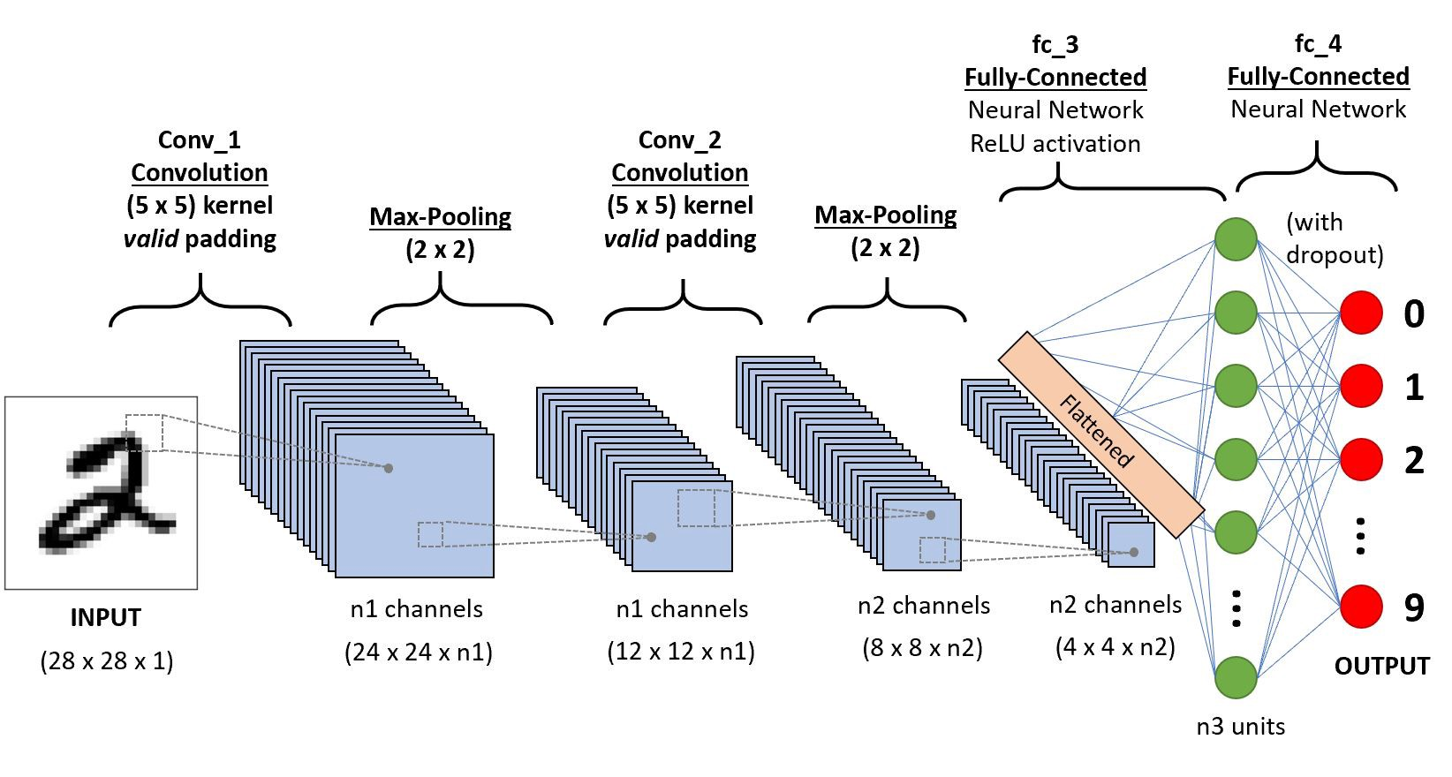
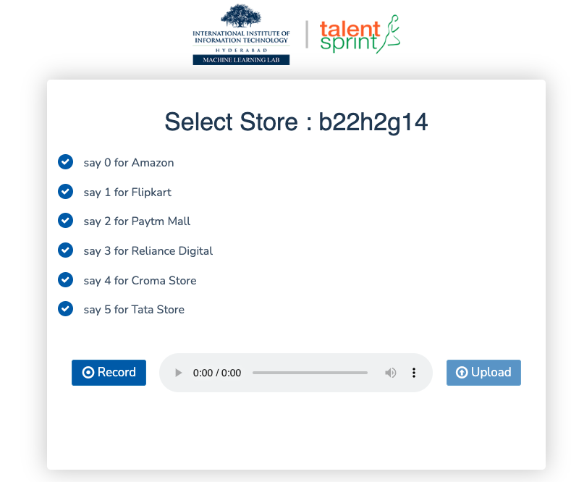
[AI design]: Voice command processing stages
Stage #1
CNN
Model Creation
Stage #2
Load Team Data
Concatenate Studio data with Team Data
Deploy
Deploy

Slide 4
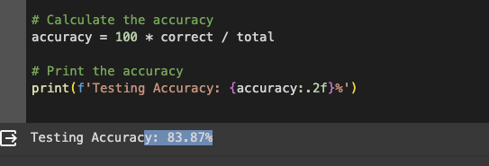
[AI design]: stage #1
Extract features and labels of Studio data
Defining CNN with below configurations
Conventual layers: 3
In_Channel: 900 to 200 range
Out_Channel: 400-100 range
Activation function : Relu
Maxpool: 3
Pre processing of Output: Softmax
Train and Classify on studio Data
C

Slide 5
[AI design]: stage #2

Slide 7

Thank you !
Talent Sprint
Mentors

